Slide 1
Conducting a Literature Review
Dulanjali Wijesekara
Department of Computer and Data Science
Faculty of Computing

Slide 2
Learning Outcomes
By the end of this session, students will be able to:
Explain the purpose and role of a literature review in research.
Identify and evaluate different sources of literature.
Critically read and synthesize information from multiple sources.
Develop a structured literature review chapter aligned with research objectives.
Apply Harvard referencing conventions for citation and referencing.

Slide 3
Exercise: (15 mins)
What do you want to find out?
Why do you want to research this topic?
Why does this research need to be carried out? (Is there a gap in the literature, or does it contribute to existing theory and/or management practice?)
What data/information already exists in other similar studies?

Slide 4
When undertaking your research, it is essential that you are aware of and acknowledge existing research in your chosen area.

Slide 5
What you can refer
Academic Journals
Conference Proceedings
Conference Report
General Reports
Newspapers
Magazines
Thesis: Mphil, PhD
Test Books
Internet Website

Slide 6
What Is a Literature Review?
A literature review is a systematic examination and interpretation of existing research relevant to your topic.
It is both a process and a product.
  As a Process
Searching, reading, and critically evaluating published work.
Developing insights into theories, debates, and methodologies.
  As a Product
A written synthesis in your thesis/report that summarizes, compares, and critiques prior research.
  Example definition:
    “A literature review identifies, evaluates, and critically assesses what has been published on a topic to understand its current state of knowledge.” (Knopf, 2006)

Slide 7
Nature of a Literature Review:
In the context of your research, ‘literature’ means all sources of published material (scholarly Publications).
A literature review can be described as ‘identifying, evaluating and critically assessing’ what has been published on your chosen topic.
Reviewing the literature critically will allow you to develop an understanding of previous research that is relevant to your own study.

Slide 8
Why Conduct a Literature Review?
To understand what is already known about a topic.
To avoid duplication of existing work.
To identify research gaps and new research opportunities.
To build theoretical grounding for your study.
To justify your research questions and hypotheses.
To position your work in the academic conversation.

Slide 9
Functions of a Literature Review
A good literature review:
Maps the conceptual framework of your study.
Identifies patterns, contradictions, and trends.
Evaluates methodologies used in prior studies.
Highlights limitations and proposes future directions.
Provides justification for your study design.

Slide 10
Sources of Literature
Primary Sources
Empirical journal articles
Conference papers
Dissertations (PhD/MPhil)
Secondary Sources
Review papers
Textbooks
Theoretical discussions
Grey Literature
Reports, policies, white papers
News articles, magazines, organizational documents
Digital Databases
Google Scholar
IEEE Xplore
Scopus / ScienceDirect
ResearchGate
ProQuest
SpringerLink

Slide 11
Searching the Literature – Step by Step
Define your keywords using synonyms and related terms.
  Example: “Artificial Intelligence,” “Machine Learning,” “Deep Learning.”
Set parameters:
  Time range (e.g., 2019–2024)
  Geography (e.g., South Asia)
  Domain (e.g., agriculture, education)
Use databases and tools (Google Scholar alerts, Scopus filters).
Screen and shortlist papers based on abstracts and relevance.
Record and manage references using Mendeley or Zotero.

Slide 12
Boolean Operators in Literature Search
you can use Boolean operators — special words (AND, OR, NOT) — to combine or exclude keywords in your search.
  Broaden or narrow your search results
  Make searches more precise and relevant to your topic
Operator | Function | Example | What It Does
AND | Narrows the search by requiring both terms to appear | AI AND Education | Finds results that include both “AI” and “Education” together.
OR | Broadens the search by allowing either term | Artificial Intelligence OR Machine Learning | Finds results containing either “Artificial Intelligence” or “Machine Learning”.
NOT | Excludes terms you don’t want | AI NOT Gaming | Finds results about AI but excludes those related to gaming.

Slide 13
Examples
When searching, databases let you add filters to refine results:
Year range: Limit to 2019–2025 for up-to-date studies.
Keywords: Include specific terms (e.g., “adaptive learning,” “LMS”).
Document type: Journal articles only, excluding books or reports.
Language: English or other preferred languages.

Slide 14

Have you heard about critical thinking..?

Slide 15
goes beyond summarizing — it involves analysis, evaluation, and reflection.

Slide 16
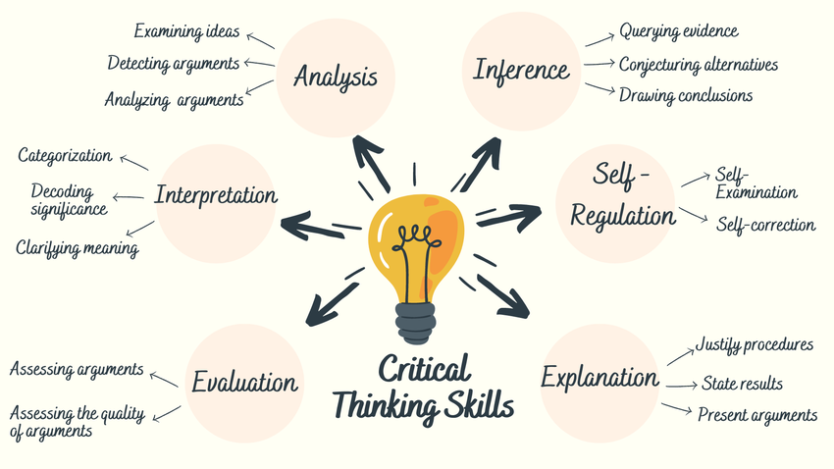

Slide 17
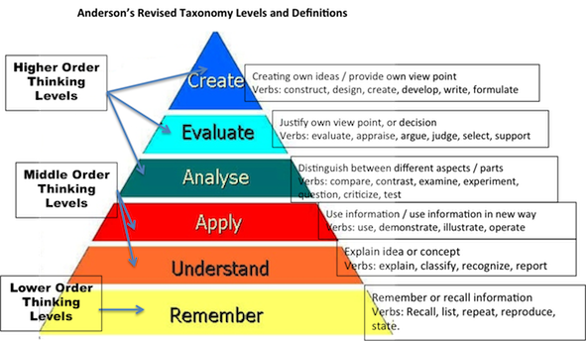
Why is it so important to write critically?! Bloom’s Taxomony: Cognitive Domain (1956) as revised by Anderson & Krathwohl (2001)

Slide 18

Critical thinking
(a three-year-old’s guide)
  Why?
  How does that work?
  What’s that made of?
  What’s that for?
  What does that mean?
  But X says…
  How do you know?
  So what?
  Says who?
  What happens if…
Notes:
To run this as an exercise, you can read out (or get them to read in groups) a text and ask them to shout out a relevant question as you go, indicating where they find it problematic, either in terms of its validity or the level of explanation it provides.

Slide 19
What critical thinking can mean in terms of the literature review
Understanding research on its own terms – testing its viability
1
Understanding research in relation to other arguments
2
Critiquing research in relation to what you want to do
3

Slide 20
Ask…
Criteria | Questions to Ask
Purpose | What was the author trying to achieve?
Methodology | Is it suitable and valid?
Results | Are they significant and reproducible?
Implications | How does it relate to your problem?

Slide 21

Synthesizing Information
Synthesis = connecting ideas, not just summarizing them.
  Compare and contrast studies.
  Identify relationships between variables and theories.
  Highlight trends and emerging themes.
  Develop a conceptual map to visualize these connections

Slide 22
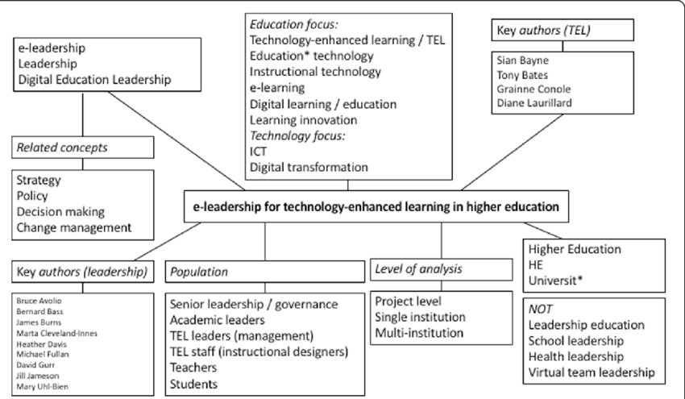

Slide 23
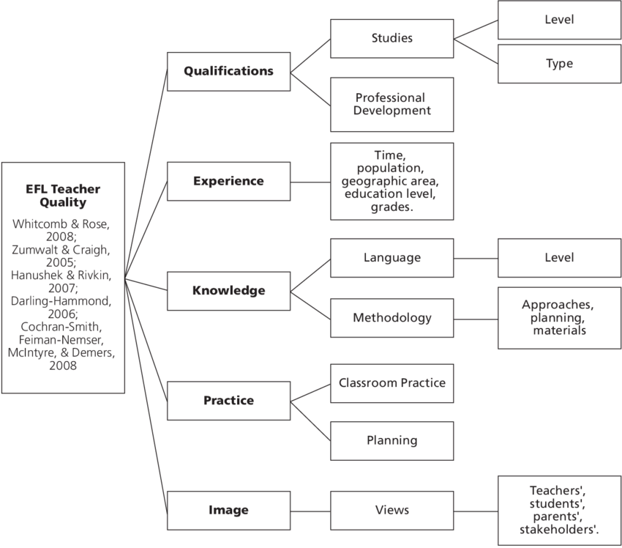

Slide 24
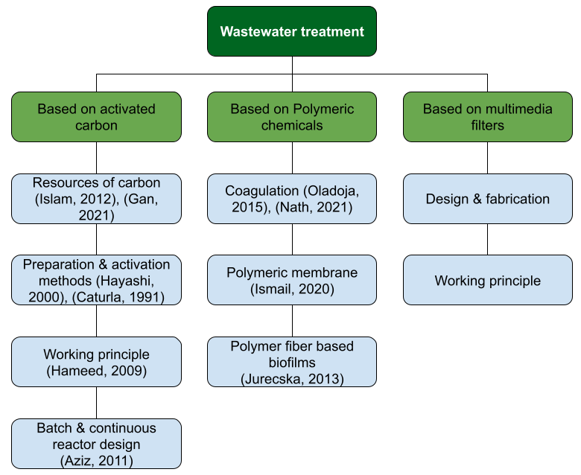

Slide 25
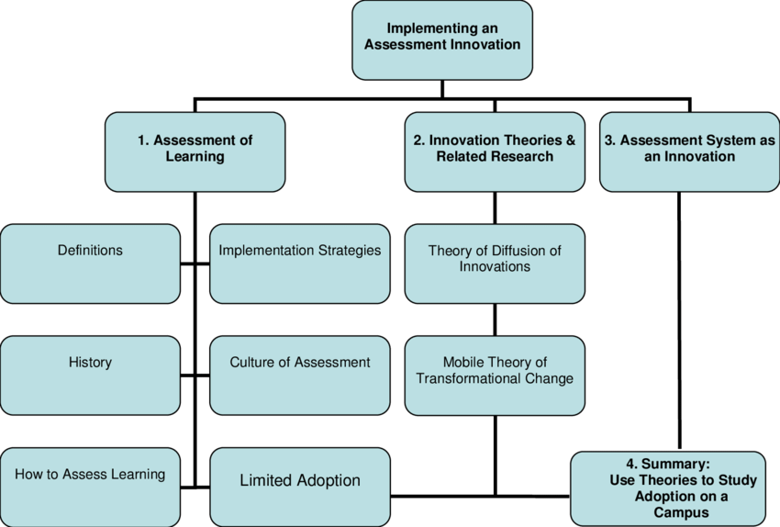

Slide 26
Effective Writing Tips
Each paragraph has one central idea.
Sentences logically connect using linking phrases (However, Moreover, In contrast).
Avoid redundancy and filler words.
  Paragraph model:
  Topic sentence → Evidence → Comparison → Critique → Link to your study.
Example:
  While most studies (Lee, 2021; Kumar, 2022) highlight AI’s role in efficiency, few address ethical data usage in Sri Lankan schools, indicating a contextual research gap.

Slide 27
Quoting, Paraphrasing & Summarizing
Type | Description | Example
Quotation | Using exact words with citation. | “AI improves decision-making efficiency” (Smith, 2022, p. 45).
Paraphrase | Rewriting in your own words, keeping original meaning. | Smith (2022) emphasizes that AI allows more accurate decisions.
Summary | Condensing key points. | AI tools enhance precision and speed in managerial tasks (Smith, 2022).

Slide 28
Referencing and Citations (Harvard Style)
In-Text Citation:
  (Author, Year) or Author (Year)
Reference List Example:
  Vargo, S.L., & Lusch, R.F. (2012). Evolving to a new dominant logic for marketing. Journal of Marketing, 68, 1–17.
Referencing means giving proper credit to the original sources you use in your research.
In IEEE style, we use numbers in square brackets [ ] to identify sources in the text — these numbers correspond to a numbered reference list at the end of your report or thesis.

Slide 29
IEEE References
Example:
“Artificial Intelligence in agriculture has shown significant growth [2]. Several machine learning frameworks have been introduced [3], [4].”
Feature | Description | Example
In-text citation | Use a number in brackets [ ] immediately after the reference. | AI improves decision-making [1].
Reference list | All references are numbered in the order they appear in the text. | [1] S. L. Vargo and R. F. Lusch, “Evolving to a new dominant logic for marketing,” Journal of Marketing, vol. 68, no. 1, pp. 1–17, 2012.

Slide 30

General Format rules
Use
Use square brackets for numbers [1], [2], etc.
Reference
Reference numbers appear inside punctuation, e.g., “...systems [4].”
List
List references in the order of appearance, not alphabetically.
Do not repeat
Do not repeat a reference with a new number — reuse the original number.
Include up
Include up to six authors; for more, list the first author followed by et al.

Slide 31
Common Reference Types
Type | Format | Example
Journal Article | [#] A. Author, “Title,” Journal Name, vol. x, no. x, pp. xxx–xxx, Year. | [1] J. W. Knopf, “Doing a literature review,” PS: Political Science & Politics, vol. 39, no. 1, pp. 127–132, 2006.
Conference Paper | [#] A. Author, “Title,” in Proc. Conf. Name, Location, Year, pp. xxx–xxx. | [2] R. Perera and D. Wijesekara, “Smart irrigation scheduling for paddy cultivation,” in Proc. Int. Conf. on IoT Systems, Colombo, 2023, pp. 101–108.
Book | [#] A. Author, Book Title, Edition. City, Country: Publisher, Year. | [3] L. W. Anderson and D. R. Krathwohl, A Taxonomy for Learning, Teaching, and Assessing, New York, NY: Longman, 2001.
Website | [#] Author/Org, “Title,” Website Name, Date. [Online]. Available: URL (Accessed: Month, Day, Year). | [4] IEEE, “IEEE Citation Guidelines,” IEEE.org, 2024. [Online]. Available: https://www.ieee.org (Accessed: Oct. 12, 2025).

Slide 32
Structure of a Literature Review
A literature review can be structured in three main ways:
Thematic
  Organizes content around themes or topics.
  Example: “AI in education” → (a) adaptive learning, (b) student analytics, (c) ethical AI.
Chronological
  Presents how the topic evolved over time.
  Example: 2010–2015: AI theory development → 2016–2020: adoption → 2021–present: ethics.
Methodological
  Compares different methods, approaches, or theoretical models.
  Example: comparing regression vs neural networks in CKDu prediction.

Slide 33
Tools…..
Task | Tools
Searching literature | Google Scholar, Scopus, IEEE Xplore
Managing references | Mendeley, EndNote, Zotero
Reading & summarizing | Paper Digest, Scholarcy
Thematic analysis | NVivo, VosViewer,wordcloud
Paraphrasing & grammar | Grammarly
Visualization | Miro, MindMeister, Lucidchart

Slide 34

Read Literature to Inspire Your Writing…!!!
Read… Read,,, Read:::

Slide 35

List of references
[1] J. W. Knopf, “Doing a literature review,” PS: Political Science & Politics, vol. 39, no. 1, pp. 127–132, 2006.
[2] L. W. Anderson and D. R. Krathwohl, A Taxonomy for Learning, Teaching, and Assessing: A Revision of Bloom’s Taxonomy of Educational Objectives, New York, NY, USA: Longman, 2001.
[3] J. Hart, Doing a Literature Review: Releasing the Social Science Research Imagination, 3rd ed., London, U.K.: Sage, 2018.
[4] J. Booth, A. Sutton, and D. Papaioannou, Systematic Approaches to a Successful Literature Review, 3rd ed., London, U.K.: Sage, 2021.
[5] D. Denyer and D. Tranfield, “Producing a systematic review,” in The SAGE Handbook of Organizational Research Methods, D. A. Buchanan and A. Bryman, Eds. London, U.K.: Sage, 2009, pp. 671–689.
[6] OECD, “OECD definition of grey literature,” Organisation for Economic Co-operation and Development, 2019. [Online]. Available: https://www.oecd.org. (Accessed: Oct. 12, 2025).
[7] P. Auger, Information Sources in Grey Literature, 4th ed., London, U.K.: Bowker Saur, 1998.
[8] R. Adams, “How to use Boolean operators in database searches,” University of Leeds Library Guide, 2023. [Online]. Available: https://library.leeds.ac.uk. (Accessed: Oct. 12, 2025).
[9] IEEE, “IEEE citation guidelines,” IEEE Editorial Style Manual, 2024. [Online]. Available: https://www.ieee.org. (Accessed: Oct. 12, 2025).
[10] Grey Literature International Steering Committee (GLISC), “Guidelines for the production of scientific and technical reports,” 2006. [Online]. Available: https://www.glisc.info. (Accessed: Oct. 12, 2025).

Slide 36
Conducting a methodical review is not an easy task.
To be sure, it is not something that you can do over the course of a weekend!
In truth, your review is likely to take several months.
the amount of literature available;
the accuracy of data; and
access to data.

Slide 37
Jeffrey W. Knopf (2006: 127) suggested that a literature review has two key elements.
First,
it should concisely summarize the findings or claims that have emerged from prior research efforts on a subject.
Second, a literature review should reach a conclusion about how accurate and complete that knowledge is; it should present your considered judgments about what’s right, what’s wrong, what’s inconclusive, and what’s missing in the existing literature.

Slide 38
Guide to conducting a literature review
It is very important to start exploring the literature as soon as possible. If initially, your research project is still fairly unfocused, your search will be in general terms only. (use your RQ and RO)
Decide the scope of your research and set your parameters accordingly (e.g. by the period of time, geography, or industry).
Determine the keywords, including alternative spellings, synonyms, and differences in usage.
Only collect articles, books, papers, etc. which are relevant to your research (e.g. in terms of subject matter, methodology, research instrument, theoretical discussion). Good research articles should review the literature, describe the research methodology used in the study, discuss the results and draw conclusions.
Use the references given in the literature you have collected to guide you to other articles you should collect.
When you start to recognize the references cited in other works, you are nearing the end of your first search.
In order to keep up to date with the literature, it is important that you continue your literature search throughout your study.

Slide 39
What if I can’t find any relevant sources?
• you are looking for the wrong type of source;
• you are looking in the wrong place;
• you have problems with the parameters or keywords for your research;
or
• you really have found an uncharted research area.

Slide 40
Starting to think about your own literature review
Who are the key players in my field? This could be anything from academics, professionals, governing bodies, schools of thought etc. (Sources!)
What are the main ideas/debates in my field?
How have these ideas changed over time?
What are some of the problems with these ideas/debates? Is there a problem with the methodology?
What are you going to do differently?

Slide 41
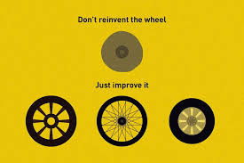

Slide 42
Gather more data regarding your research:
Search for literature that match with your domain/topic:
HOW TO DO THIS
1
Google Scholar: https://scholar.google.com/
Research Gate
IEEE Digital Explorer
Many more

Slide 43
Synthesizing the information

Slide 44
Main ideas/debates
Once you have the relevant sources you can begin to think about what the key ideas, debates, methodologies etc. are in your field.
You can also think about how these ideas have changed over time.
Ask yourself:
How has the topic or problem been defined?
Are there any trends and patterns across the literature?
What methodological assumptions and approaches have been used?
What are the agreements and disagreements between theorists on my topic?

Slide 45
REFERENCING STYLE: HARVARD
Harvard referencing style uses references in two places in a piece of writing:
in the text (citation) and
in a reference list at the end.
In general, each author name that appears in the text must also appear in the reference list, and every work in the reference list must also be referred to in the main text.
https://www.mendeley.com/guides/harvard-citation-guide

Slide 46
Quoting, Paraphrasing, and Summarizing
Quotations must be identical to the original, using a narrow segment of the source. They must match the source document word for word and must be attributed to the original author.
Paraphrasing involves putting a passage from source material into your own words. A paraphrase must also be attributed to the original source. Paraphrased material is usually shorter than the original passage, taking a somewhat broader segment of the source and condensing it slightly.
Summarizing involves putting the main idea(s) into your own words, including only the main point(s). Once again, it is necessary to attribute summarized ideas to the original source. Summaries are significantly shorter than the original and take a broad overview of the source material.

Slide 47
What is a reference and citation?
A way of giving credit for someone's thinking, writing or research
You mark the material when you use it (a citation) and give the full identification at the end (a reference)
  E.g: According to Vargo and Lusch (2012) brand awareness directly make an impact on customer decision making.
  Vargo, S. L., & Lusch, R. F., (2012) Evolving to a New Dominant Logic for Marketing, Journal of Marketing, Vol. 68 pp. 1-17
In academic writing you are obliged to attribute every piece of material you use to its author
Citation
Reference

Slide 48
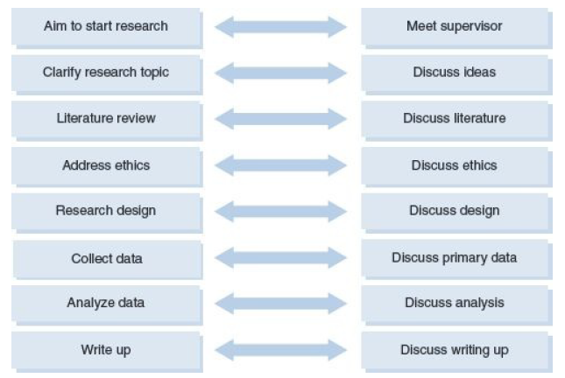

Slide 49
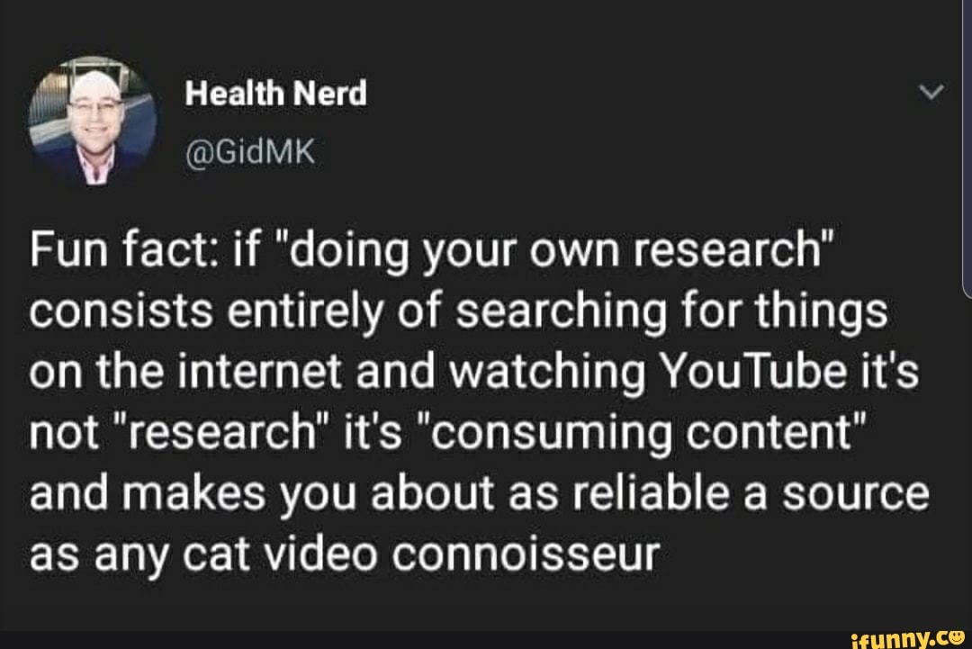
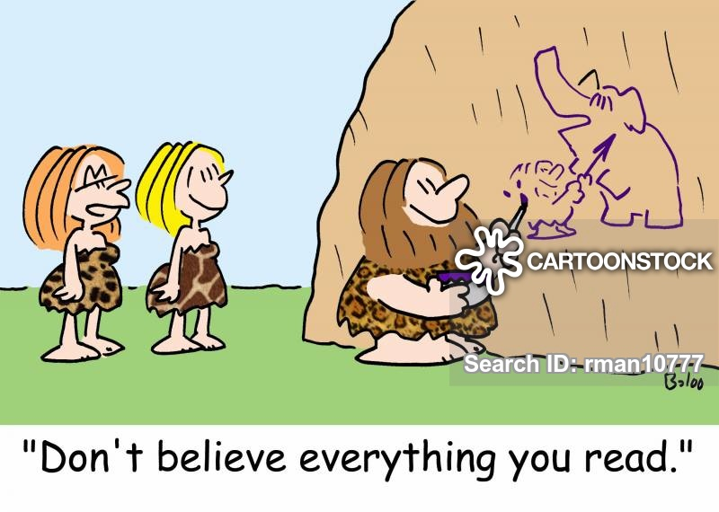
Let’s Start

